Slide 1
Capture Method Comparison for Red Drum (Sciaenops Ocellatus) using Python
Sandra Leal

Slide 2
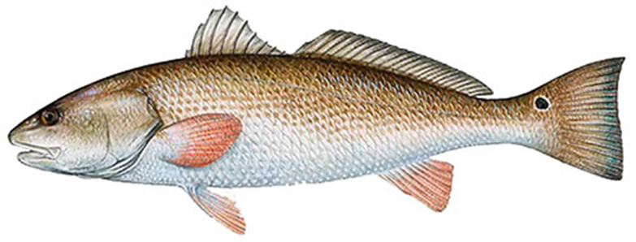
Introduction – Red Drum
Also referred to as Red Fish
Popular game fish in coastal waters
Species of great recreational significance in South Texas
Suffered population decline due to unregulated fishing
State managed species
Spawns primarily in the Gulf of Mexico

Slide 3
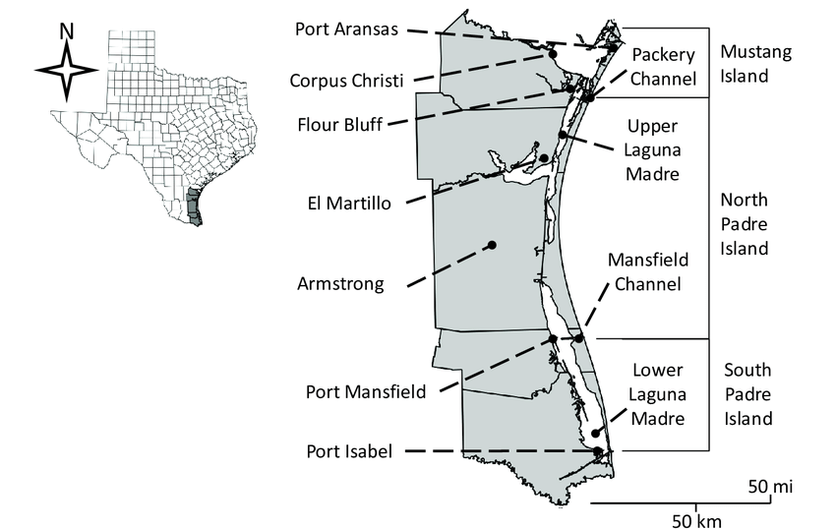
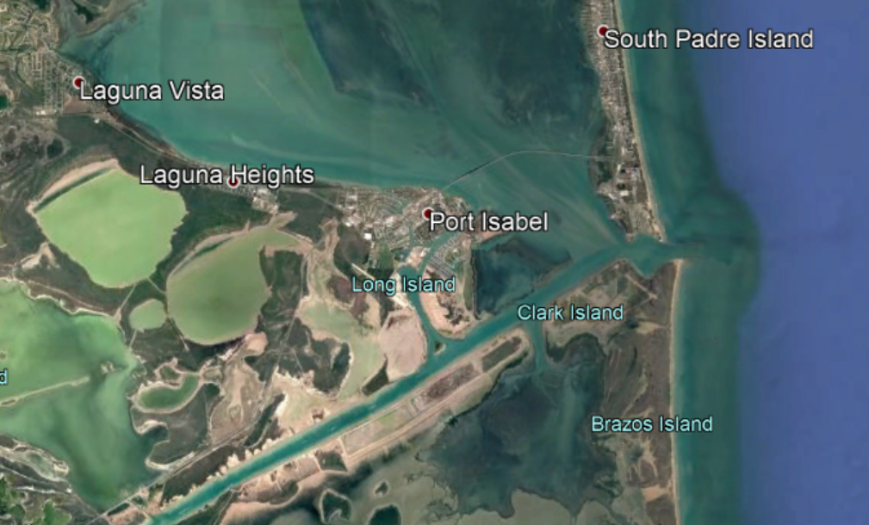
Introduction – Study Site
Lower Laguna Madre (LLM), Tx
Potential interest areas:
Holly Beach
(lagoon system)
South Bay
(bay system)

Slide 4
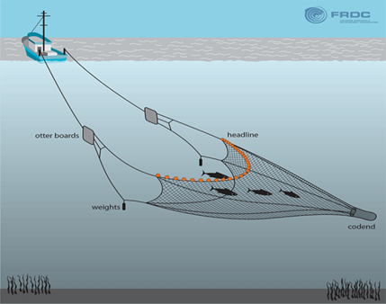
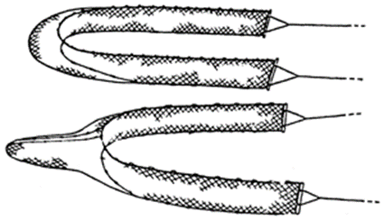
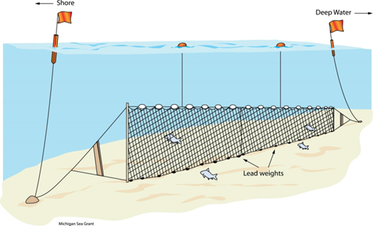
Introduction – Capture Methods
Texas Parks and Wildlife Data
Capture Methods Utilized:
Bag Seine
Gillnet
Bay Trawl

Slide 5
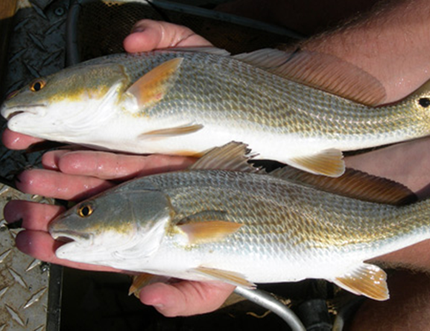
Introduction – Research Questions/Goal
Compare capture methods
Identify most effective capture method
Visualize distribution of Red Drum in LLM water systems
Identify peak aggregation months/sites
Potentially re-evaluate sample sites

Slide 6
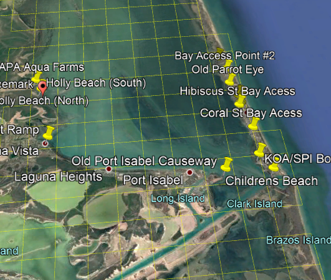
Methods - Extraction
Texas Parks and Wildlife Grids
Latitude/Longitude Data Extraction
KMZ (Google Earth) to KML

Slide 7
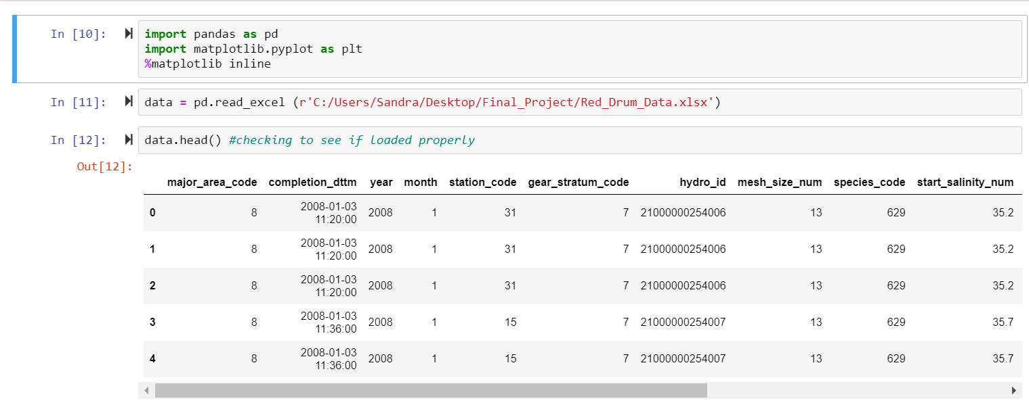
Methods - Pandas
Modify data in excel sheets
Upload into pandas
Visualize data
Scatter Plots
Histogram age class

Slide 8
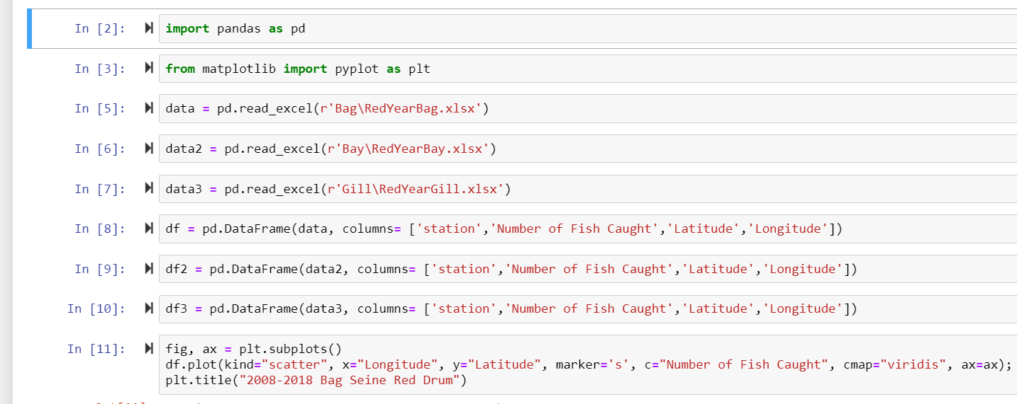
Methods- Scatterplots
Two types of scatterplots per capture method
Total fish summed from 2008-2018
Fish grouped by month and summed from 2008-2018
Three capture methods:
Bag Seine
Gillnet
Bay Trawl

Slide 9
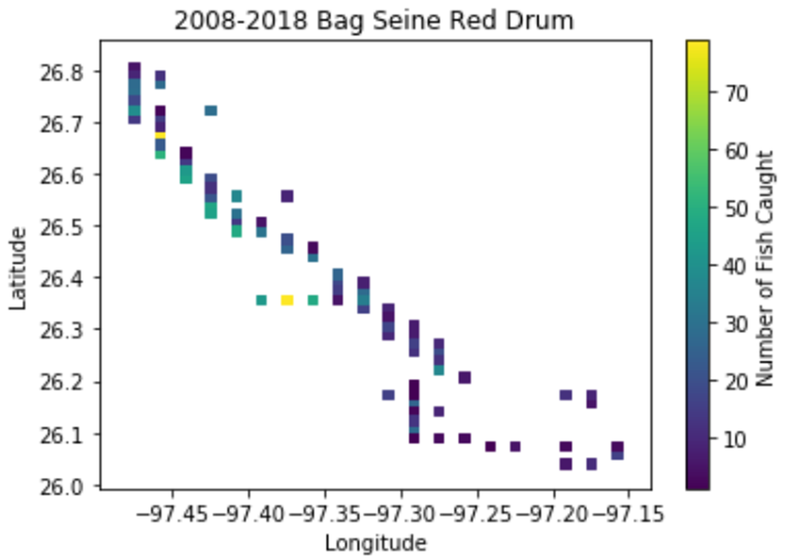
Results
Figure 1. Scatterplot of Red Drum Capture utilizing Bag Seine method summed over total timeseries

Slide 10
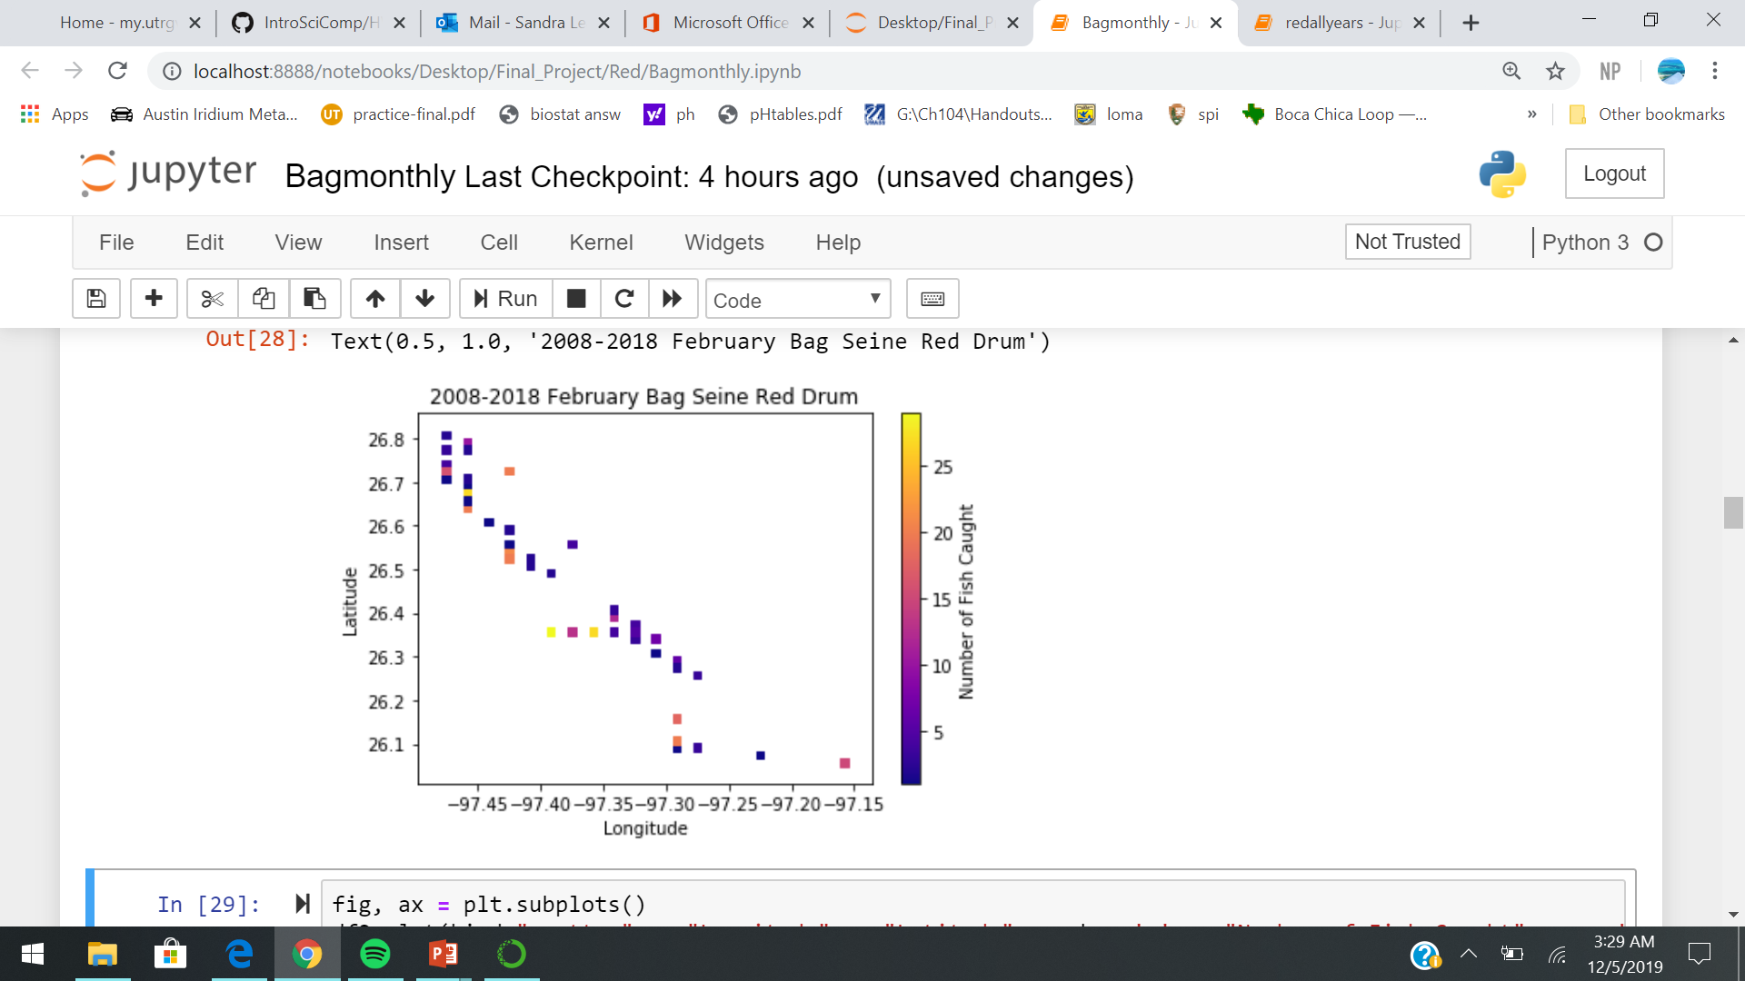
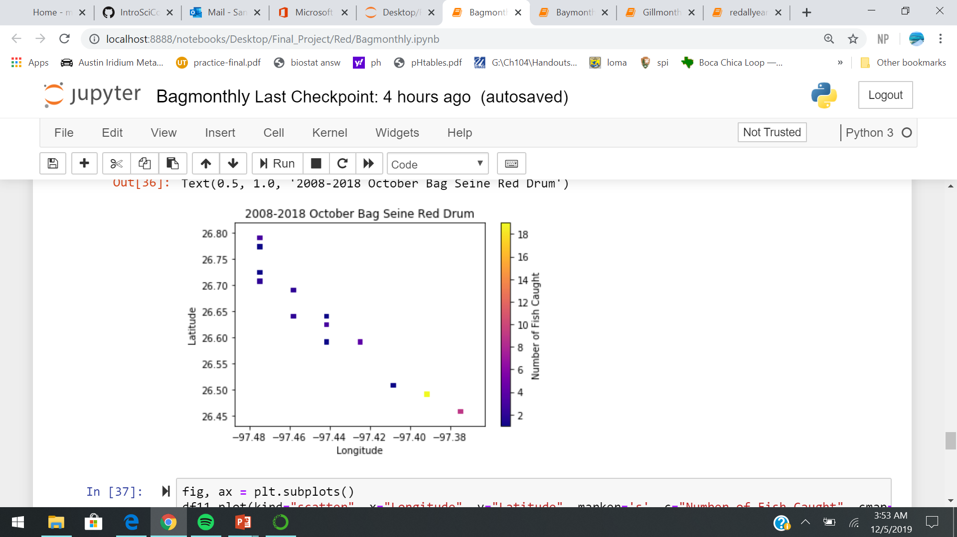
Results
Figures 2, 3. Scatterplots of fish caught grouped by month and summed from 2008 to 2018

Slide 11
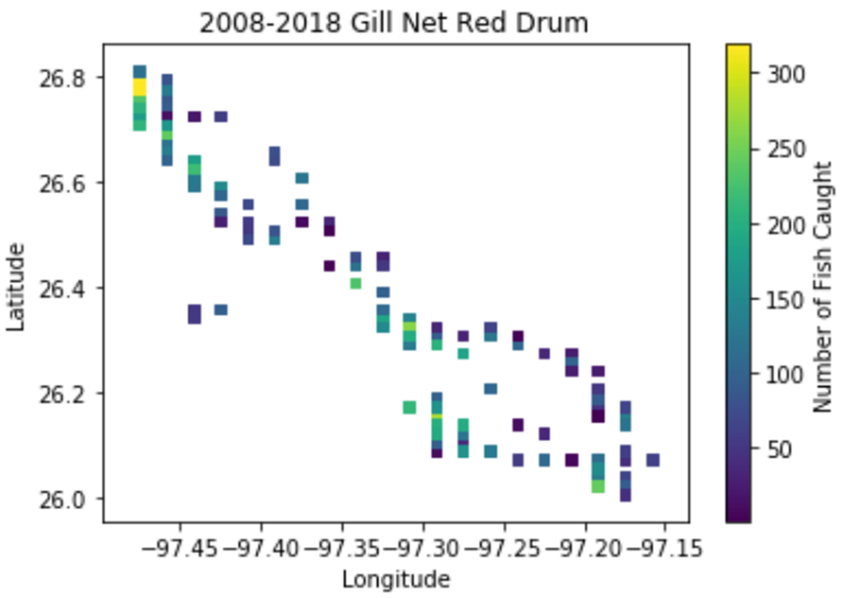
Results
Figure 4. Scatterplot of Red Drum Capture utilizing Gill Net method summed over total timeseries

Slide 12
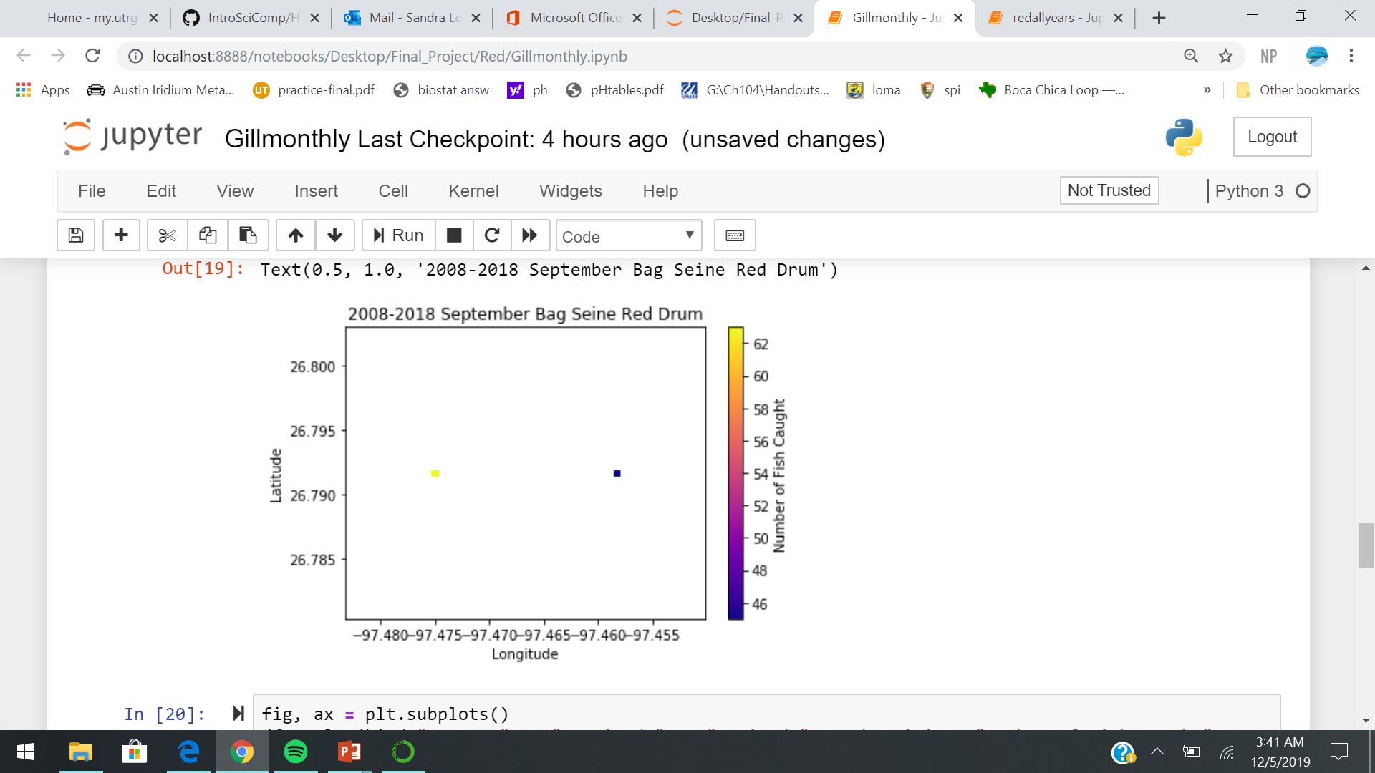
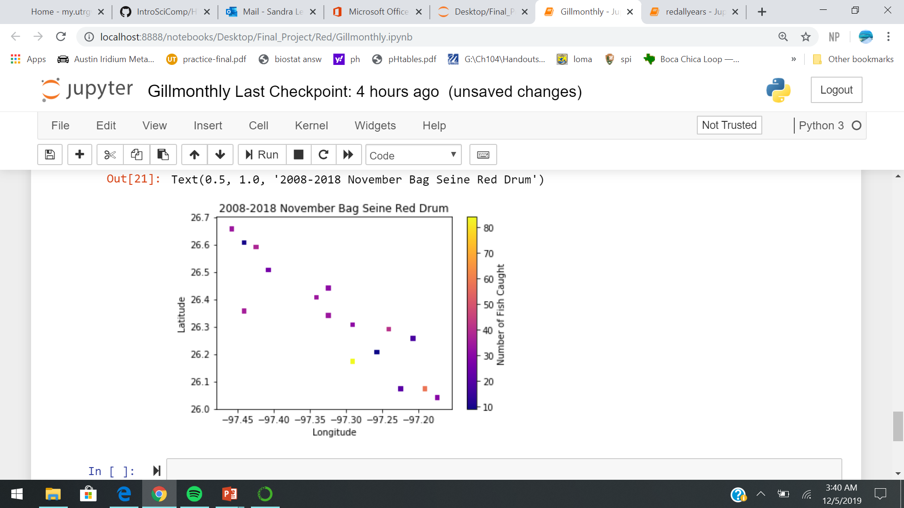
Results
Figures 5, 6. Scatter plots of fish caught grouped by month and summed from 2008-2018

Slide 13
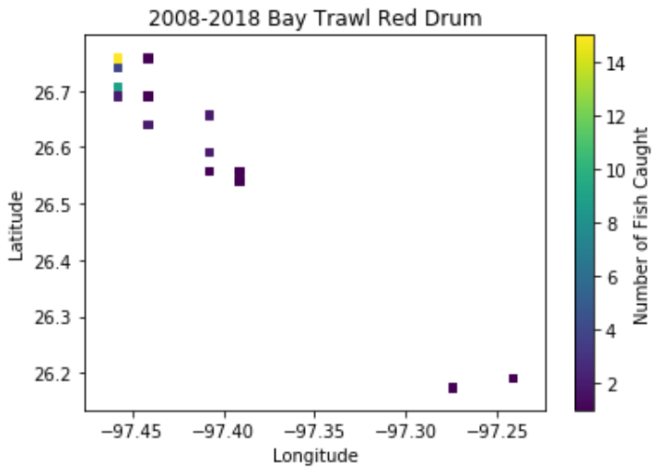
Results
Figure 2. Scatterplot of Red Drum Capture utilizing Bay Trawl method summed over timeseries

Slide 14
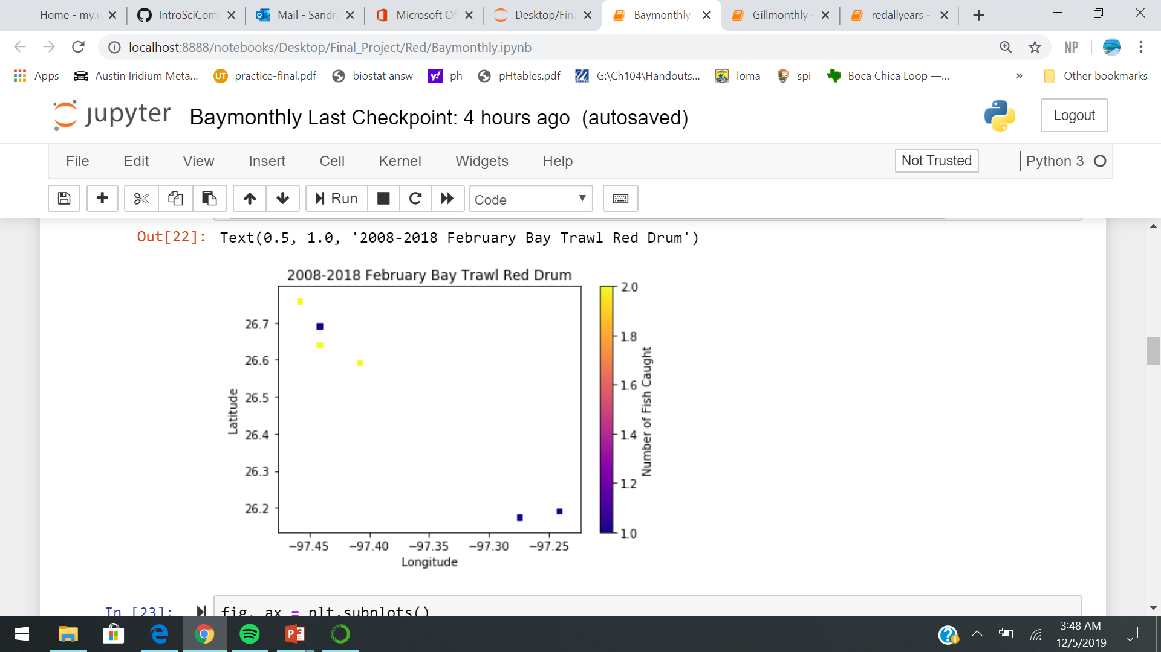
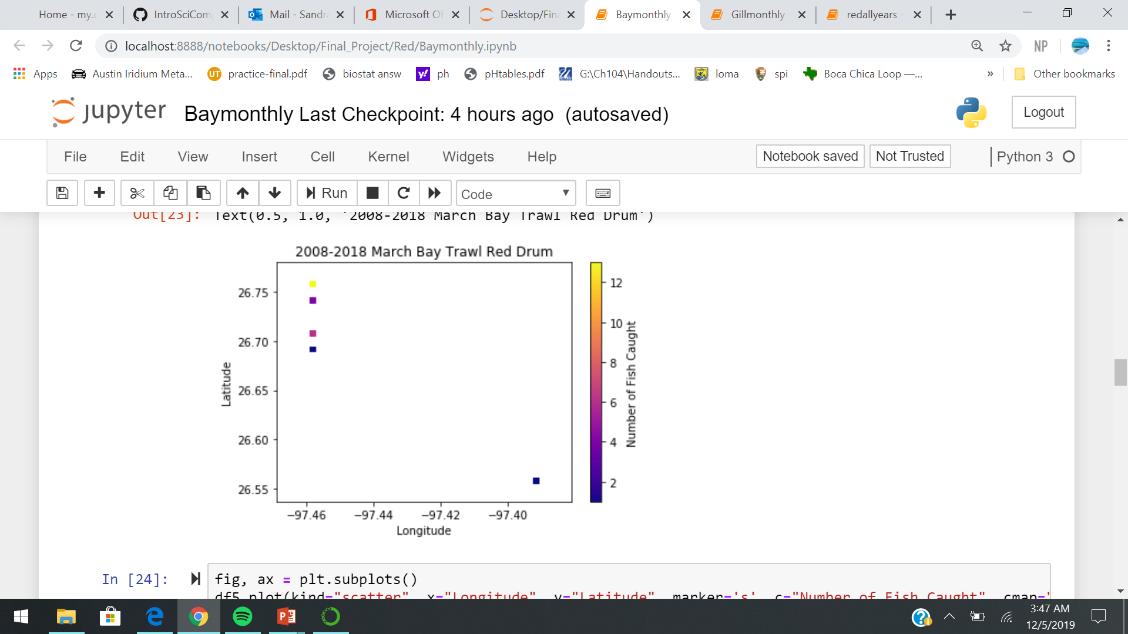
Results
Figures 8, 9. Scatterplots of fish caught grouped by month and summed from 2008-2018

Slide 15
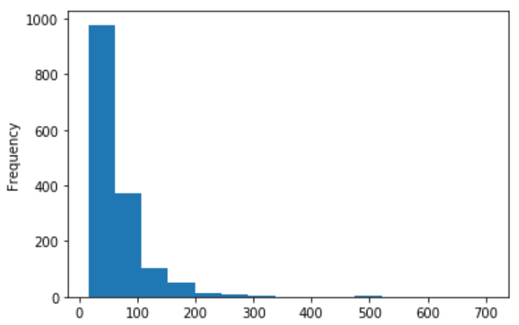
Results
Figure 10. Histogram of Red Drum Bag Seine length classes

Slide 16
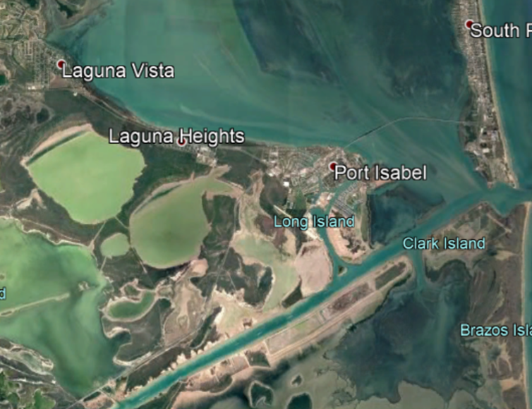
Discussion/Conclusion
Most effective method of Red Drum capture was Gill Net
Least effective method of Red Drum capture was Bay Trawl
Popular aggregation sites:
Upper portion of LLM
Holly Beach
Peak Months:
November
December
January
February

Slide 17
Black Drum and Gray Snapper
Black drum
Gray snapper
Most effective capture method was Gill Net
Least effective capture method was Bay Trawl
Popular aggregation sites:
Upper portion of LLM
Lower portion of LLM
South Bay
Most effective capture method was Gill Net
Least effective capture method was Bag Seine
Popular aggregation sites:
Lower Portion of LLM
South Bay

Slide 18
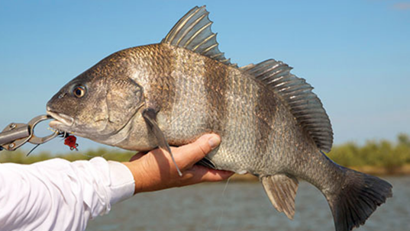
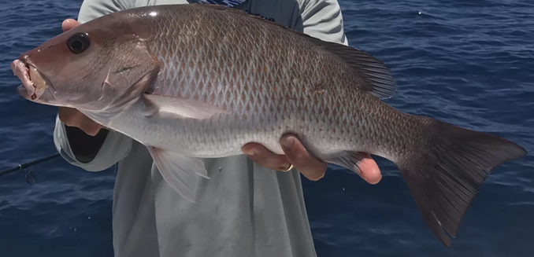
Gray Snapper and Black Drum

Slide 19

Questions?

